Slide 1
Stakanchik

Slide 2
Stakanchik fasoni truba karnizlarda (aksasuarlar,lentalarda )

Slide 3
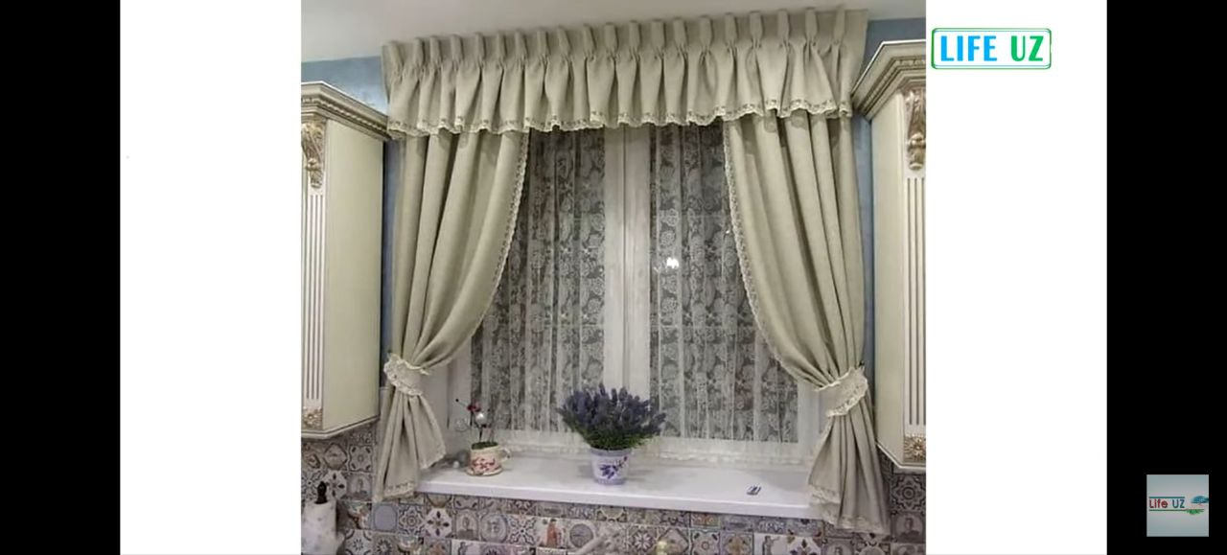
Stakanchik fasoni lampirkent ko’rinishda mini pardalar (patalochniy karniz)

Slide 4
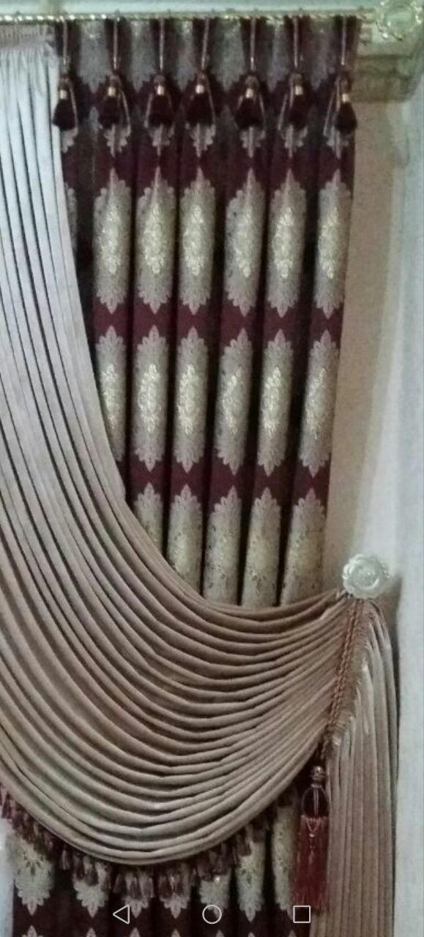
Stakanchik fasoni erkin taxlamlarda (gazlama gullarini taxlashda)

Slide 5
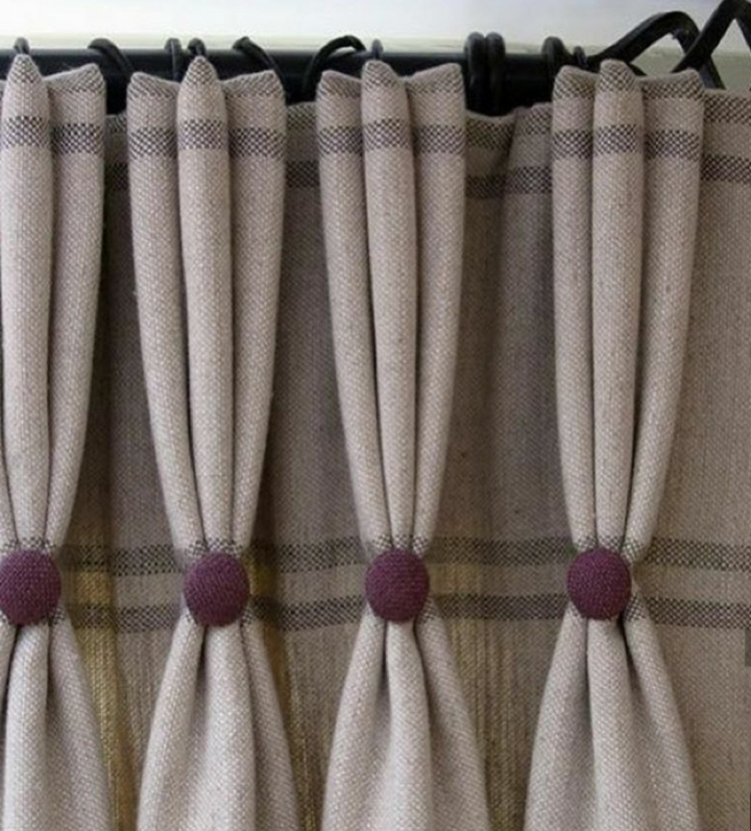
Stakanchik fasoni taxlam ko’rinishida(tugma bezaklar)

