Slide 1
Parter kachele ochiq turdagi fason

Slide 2
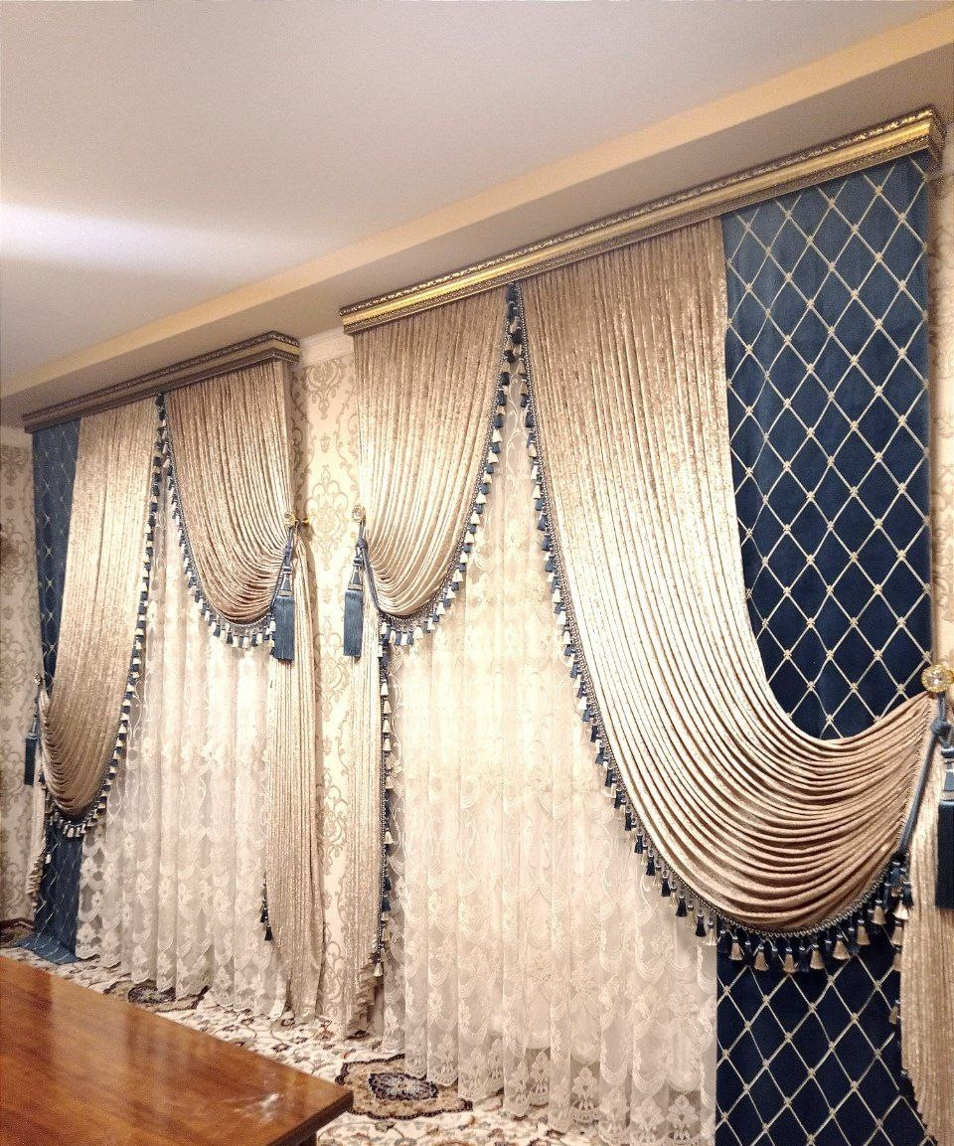

Slide 3
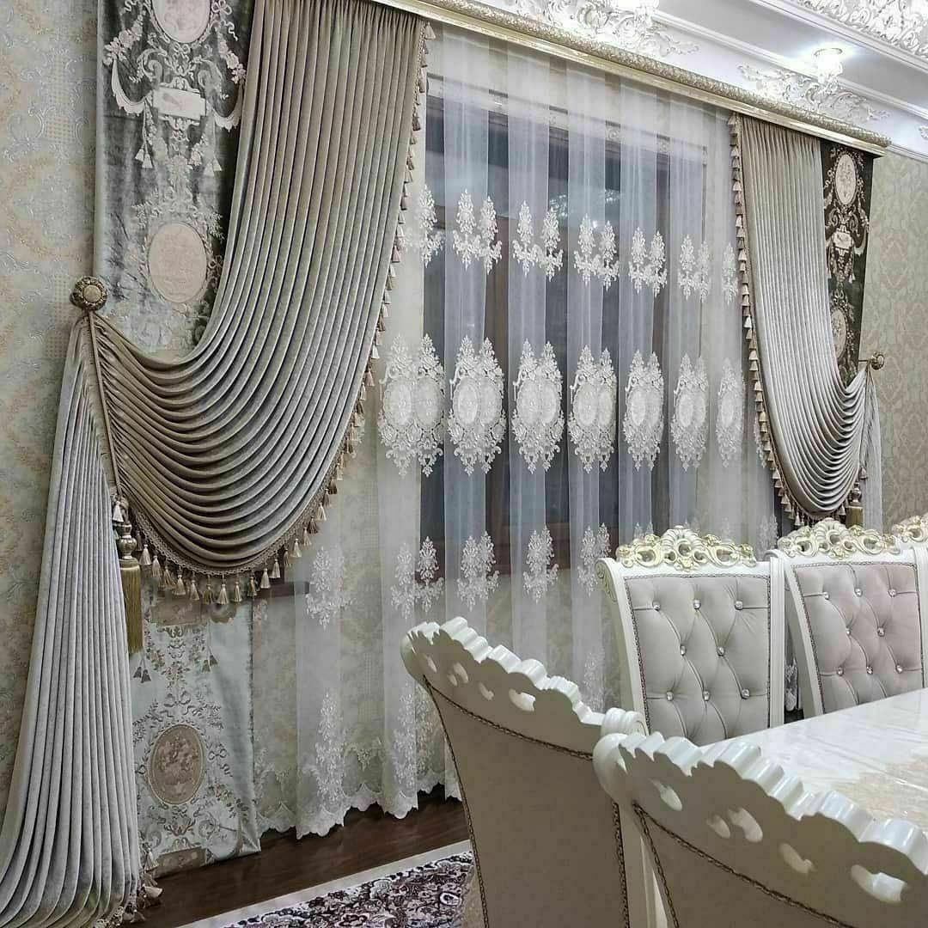

Slide 4
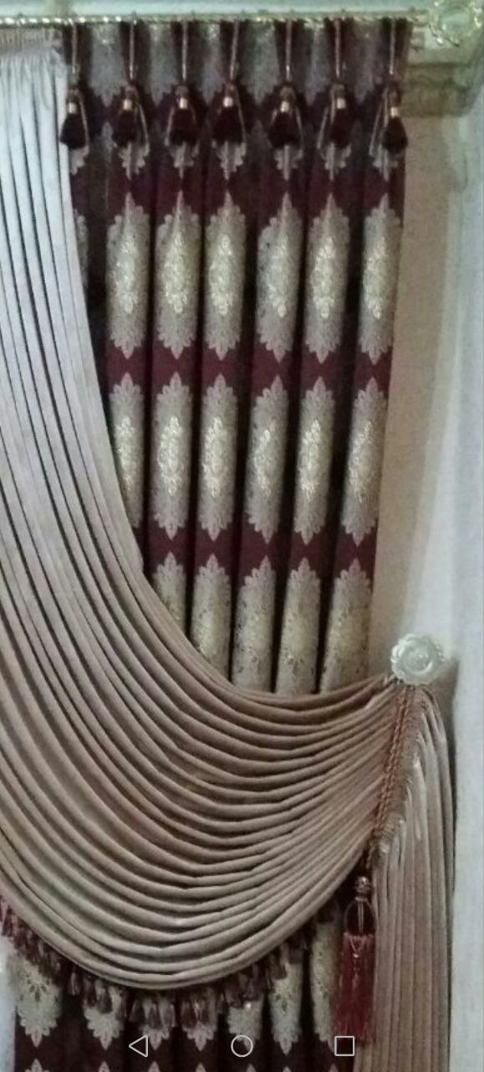

Slide 5
