Slide 1
Anjir yostiqchalar

Slide 2
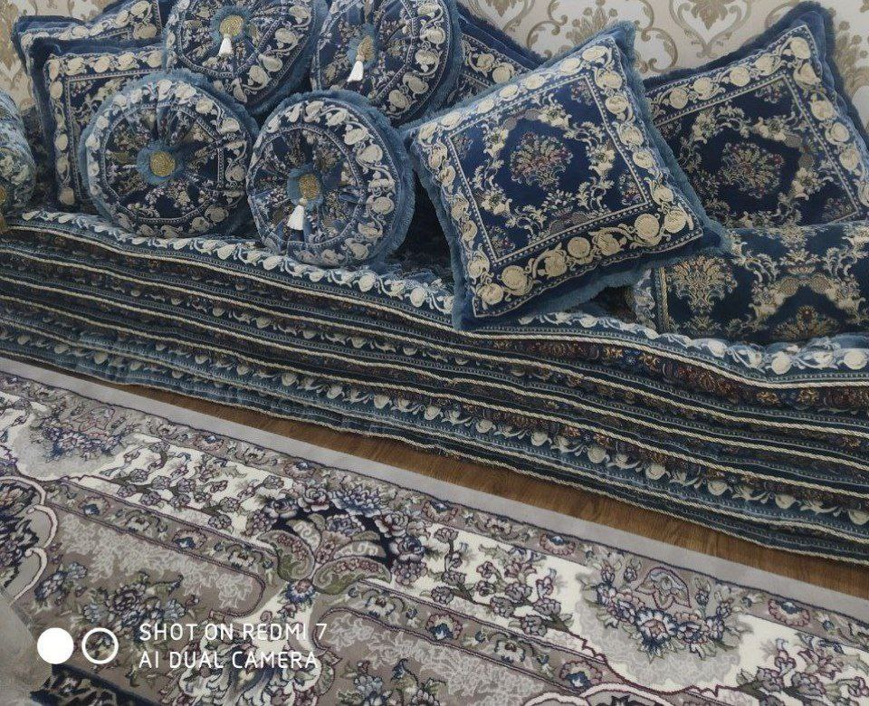
Qalin gazlamali anjir yostiqchalar

Slide 3
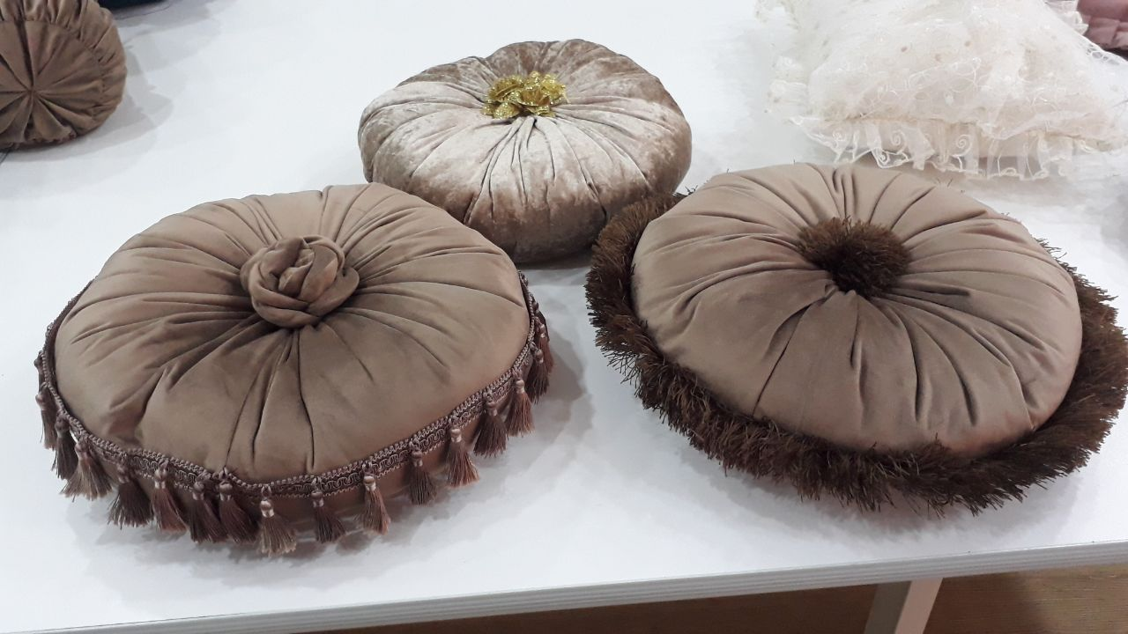
Baxramali, gulli anjir yostiqchalar

Slide 4
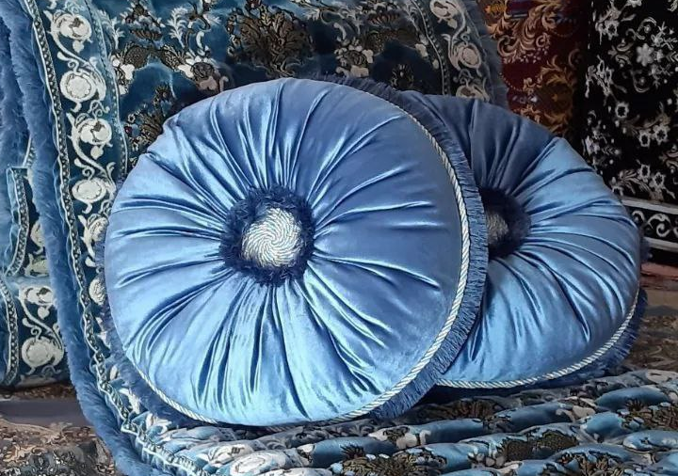
Arqonli va sochiqli anjir yostiqchalar

Slide 5
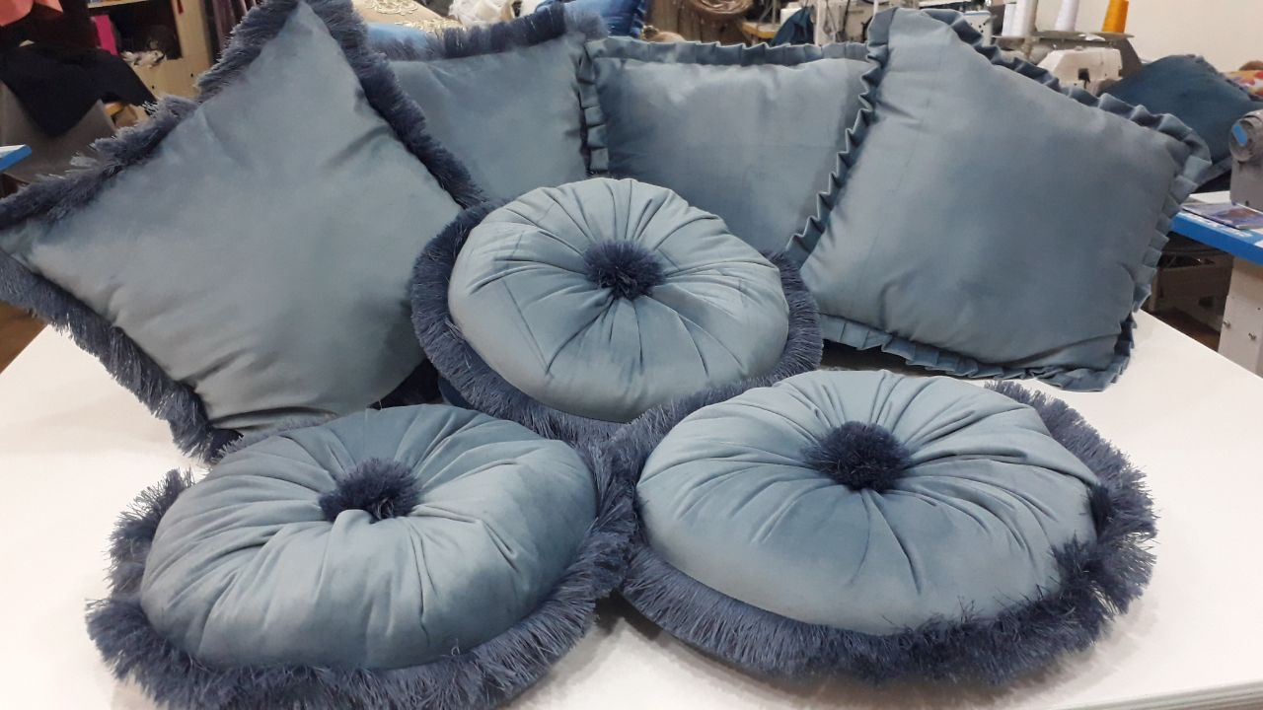
Sochiqchali anjir yostiqchalar

Slide 6
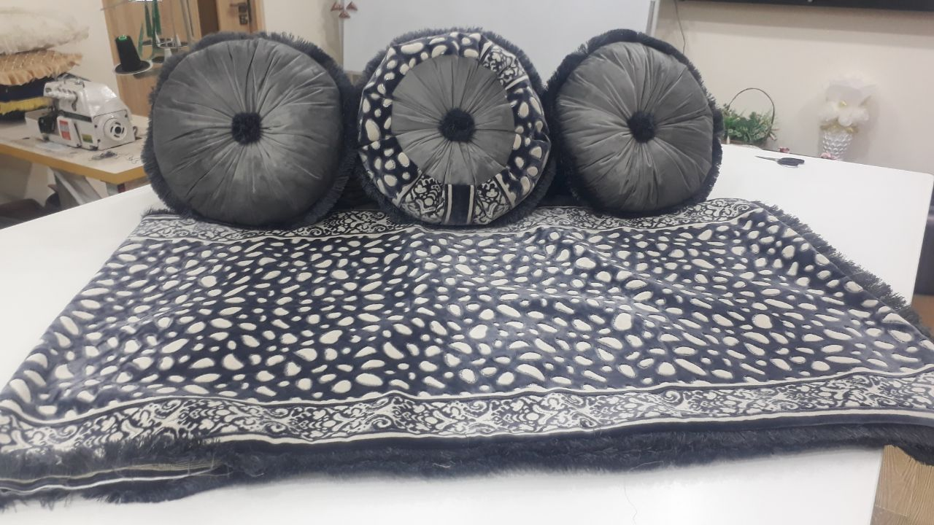
Kambirnevinni anjir yostiqchalar

Slide 7
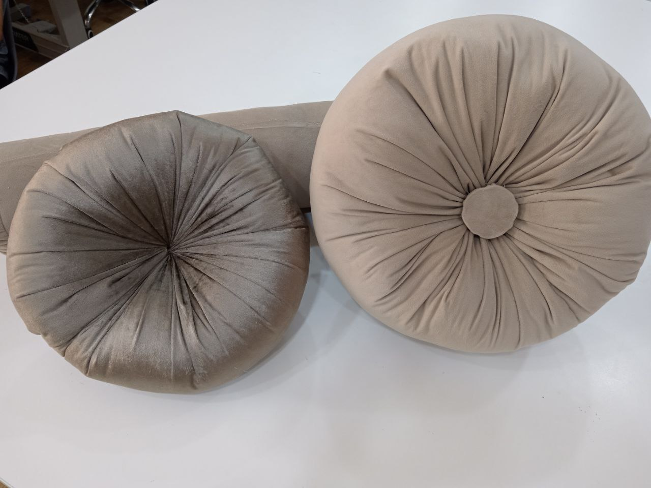
Klassik uslubdagi anjir yostiqchalar

Slide 8
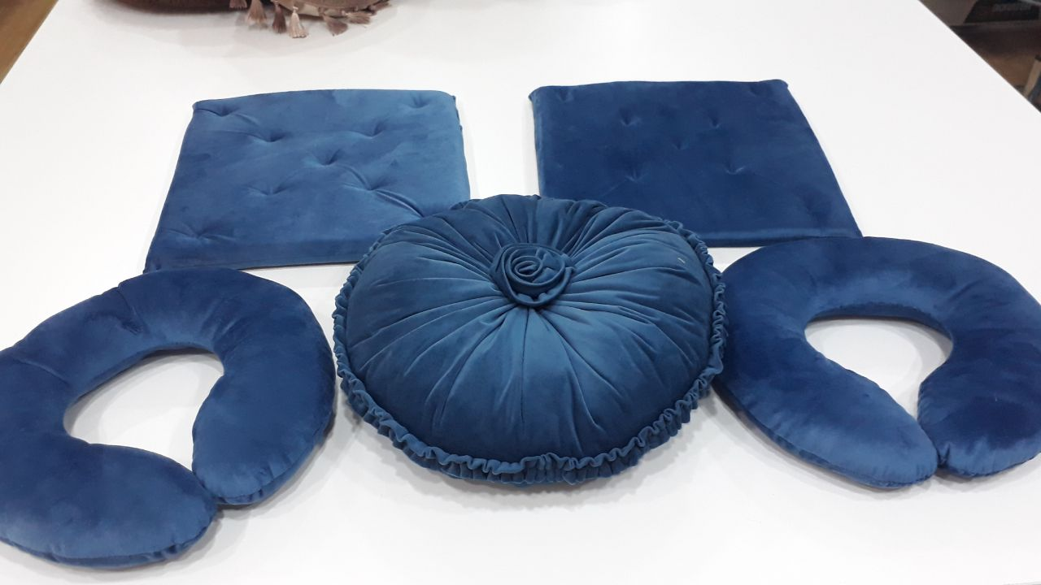
Taxlamli anjir yostiqchalar

