Slide 1
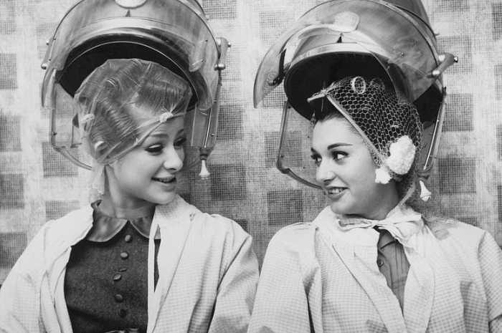
Sochlarga bigudi urash

Slide 2
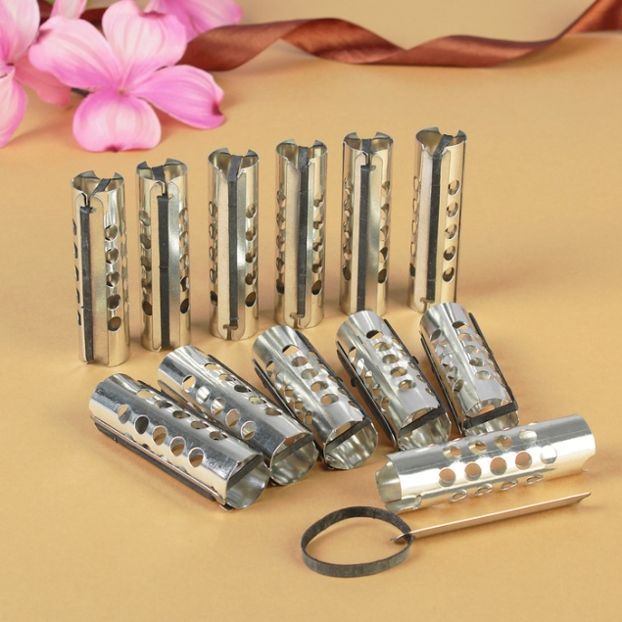
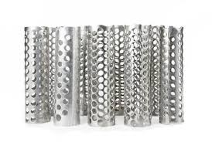
Xvii asrda urfga kirgan bigudilar avval temir bulgan

Slide 3
Keyinchalik yogoch bigudilar urf bulgan

Slide 4
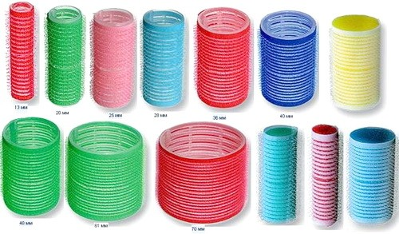
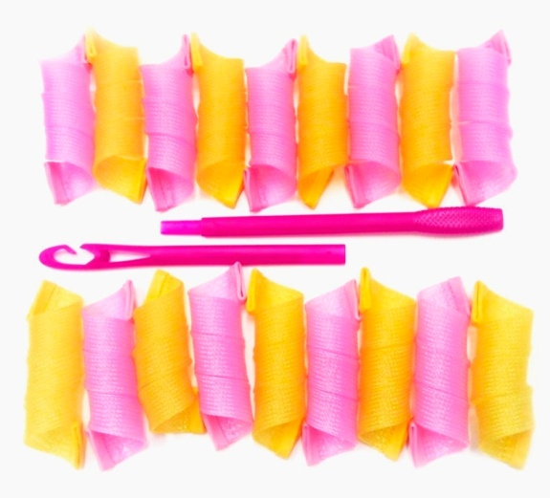
Xozirgi kunda turli bigudilar mavjud

Slide 5
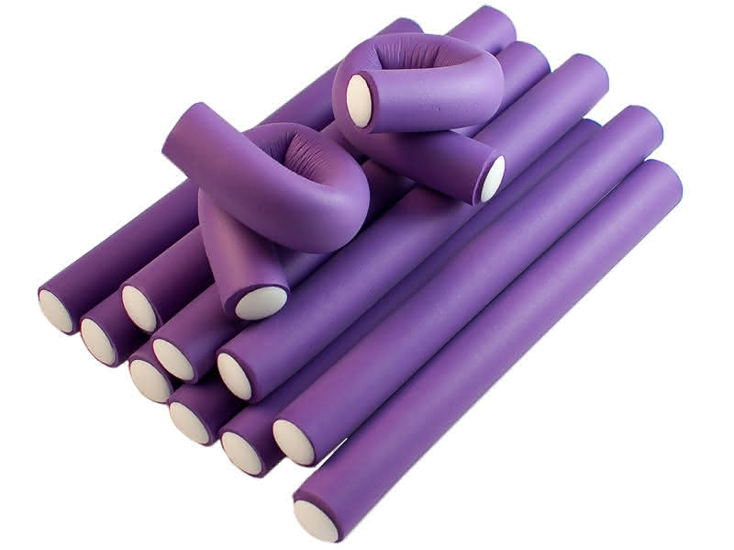
Xozirgi kun bigudilari

